Slide 1
Voice-Controlled Desktop Assistant
Using Python
Speech Recognition • Command Processing • GUI Automation
🎙 Voice Input
Python
🖥 Computer Action
1

Slide 2
Project Overview
A continuous Input → Process → Action → Output pipeline
The assistant bridges voice input with desktop automation using Python libraries.
🎙 Microphone
Speech-to-Text
Command
Processing
Computer
Action
pyttsx3 → Voice Response
Example 1
Example 2
“open notepad” → Notepad opens
“type hello world” → text is typed into the active window
2

Slide 3
Libraries Used
The components and their roles
speech_recognition
pyttsx3
pyautogui
Captures microphone audio and converts speech into text
Converts text responses into speech using the OS speech engine
Simulates keyboard and mouse input for GUI automation
os
sys
time
Executes operating-system commands such as launching Notepad
Used to identify the operating-system environment
Provides delays such as time.sleep() for synchronization
Together: Listen → Understand → Act → Respond
3

Slide 4
System Architecture
How the components connect
MICROPHONE
speech_recognition
TEXT COMMAND
process_command()
System / Application Control
Keyboard / Mouse Control
os
System Action
pyttsx3 → 🔊 Voice Response
pyautogui
Keyboard / Mouse Action
4

Slide 5
Speech-to-Text & Text-to-Speech
The assistant listens and speaks
Speech-to-Text
Text-to-Speech
sr.Microphone()
adjust_for_ambient_noise()
recognizer.listen()
recognize_google()
→ returns a text command
engine = pyttsx3.init()
engine.say(text)
engine.runAndWait()
→ speaks the assistant's response
Audio → Text
Text → Spoken Audio
Speech recognition handles input; text-to-speech handles the assistant's output.
5

Slide 6
Command Processing
Example: the user says “type hello world”
Voice
Recognition
Processing
“type hello world”
recognize_google()
process_command()
Extraction
Action
Result
remove “type ” → “hello world”
pyautogui.write()
⌨ hello world
if command.startswith("type "):
text_to_type = command.replace("type ", "", 1)
pyautogui.write(text_to_type + " ", interval=0.03)
6

Slide 7
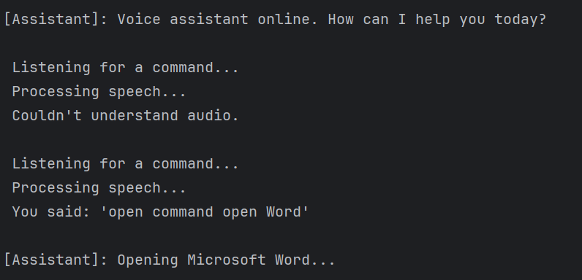
OutPut-
1

Slide 8
Conclusion
One system, multiple Python components
• Speech recognition converts spoken commands into text.
• process_command() evaluates the recognized command.
• os and pyautogui perform computer actions.
• pyttsx3 provides spoken feedback to the user.
🎙 Voice
⚙ Python Processing
🖥 Computer Action
“From spoken words to computer actions — Python turns voice into interaction.”
7

